Slide 1

You are Surrounded
Living in a world surrounded by toxins and germs, we are constantly trying
to stay one step ahead.

Slide 2

There’s No Escape
We not only
live among toxins and bacteria
we ingest them.

Slide 3

MegaDefense is the Answer!
An exclusive and powerful blend of NCD Activated Zeolite and IM6 Full Spectrum Immune Complex.

Slide 4
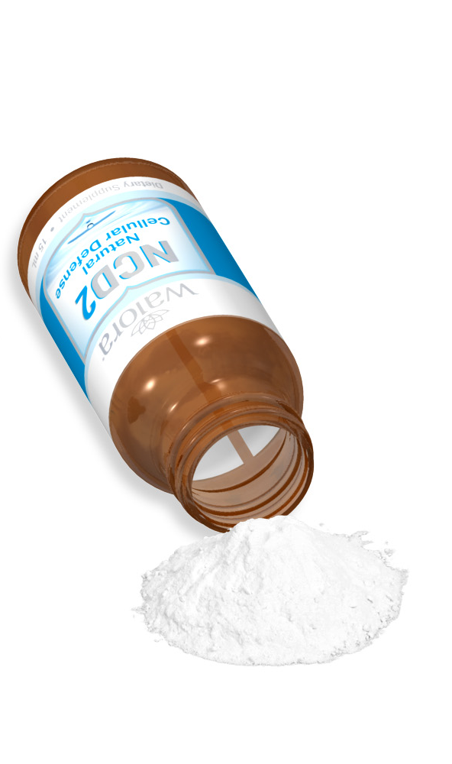
NCD Activated Zeolite
What makes NCD Activated Zeolite superior to other zeolites?
Purity
Composition
Particle size (micronization)
Activation
PROVEN EFFECTIVE!

Slide 5

NCD Activated Zeolite
What immune-boosting qualities are being tested?
Impact on tumor cells
Adjunct to cancer therapy
Anti-carcinogen
Anti-viral (oral & topically)
Fatigue recovery (exercise)
Protection from nuclear wastes
Toxins and heavy metal removal

Slide 6
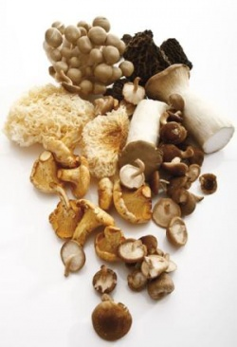
IM6 Full Spectrum Immune Complex
100& USDA & EU certified organic
Biotech lab cultivated
Non-GMO medicinal mushroom species
  Agaricus blazei
  Cordyceps sinensis
  Grifola frondosa
  Ganoderma lucidum
  Coriolus versicolor
  Lentinula edodes

Slide 7
IM6 Full Spectrum Immune Complex
What makes IM6 superior to other blends?
It’s a combination of both water-soluble heteropolysaccharides and HMW non-soluble triple helix beta glucans
Fully micronized to a maximum particle size of less than 40 microns
Micronized absorption takes place so quickly that there is no breakdown of the active polysaccharides (better beta glucan potential)
Activates all 260 different classes of immune cells (including NK cells, T cells and macrophages.

Slide 8
“The Whole is Greater than the Sum of its Parts”
It is easier for pathogens to adapt and become resistant to one mushroom than to several.
Each mushroom species has a unique arsenal of anti-infective and immunomodulating agents.
The synergy makes the blend more medicinally powerful than most.
Name of Fungus | Daily Dosage | Rate of Complete Recovery | Anti- Cancer effect
Agaricus Blazei Murill | 10mmg | 90.0% | 99.4%
Grifola umbellate | 10mmg | 90.0% | 98.5%
Phellinus yucatensis | 30mmg | 87.5% | 96.5%
Phellinus igniarius | 30mmg | 66.7% | 87.4%
Lenzites betulina | 30mmg | 57.1% | 70.2%
Tricholoma matsutake | 30mmg | 55.5% | 91.3%
Lentinus edodes | 30mmg | 54.5% | 80.7%
Coriolus versicolor | 30mmg | 50.0% | 77.5%
Pleurotus ostreatus | 30mmg | 45.5% | 75.3%
Elfringia applanata | 30mmg | 45.5% | 64.9%
Fomitopsis pincicola | 30mmg | 33.3% | 61.2%
Fomitopsis cytisna | 30mmg | 30.3% | 44.2%
Pholiota nameko | 30mmg | 30.0% | 86.5%
Flammulina velutipes | 30mmg | 30.0% | 81.1%
Ganoderma Lucidum | 30mmg | 20.0% | 77.8%
Osaki, Kato, Yamamoto, Okubo, Miyazaki 1994

Slide 9

MegaDefense Offers Superior Beta Glucan Potential
Includes the beta glucans of 6 species of medicinal mushrooms (each with slightly different polysaccharide structures)
Includes all the biologically active components from the mushroom species
Micronized to a particle size less than 40 microns, its far more bioavailable then other beta glucan products.
Result: Activates all 260 different classes of immune cells. No other product can compete!!

Slide 10
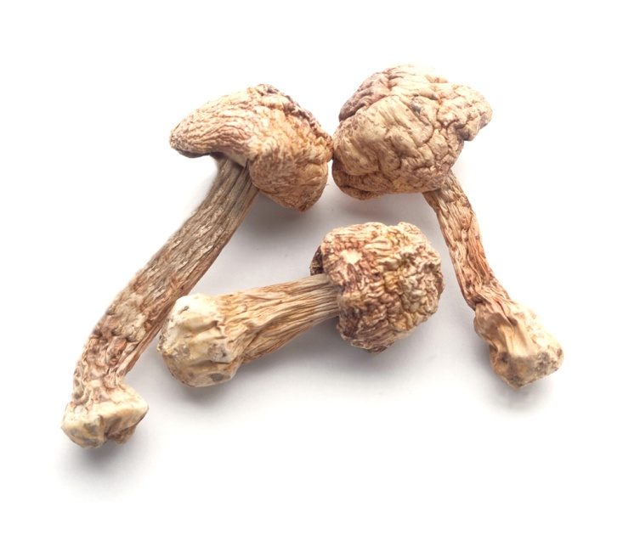
IM6 Full Spectrum Immune Complex
What makes IM6 blend different?
  No other manufacturer offers
  the IM6 Full Spectrum Immune Complex
  The manufacturer holds a
  patent on the substrate (the
  growing environment) as well as the
  extraction process with two additional patents pending.

Slide 11
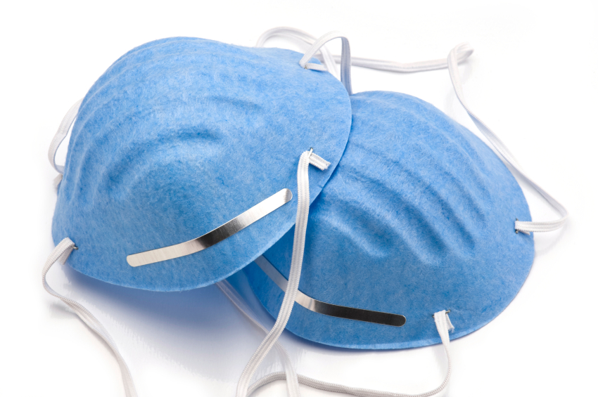
Medicinal Mushrooms
The medicinal mushrooms featured in MegaDefense are being tested against:
Chronic hepatitis
HIV
Prostate Cancer
Bladder Cancer
Breast Cancer
Diabetes
Colorectal Tumors
Ovarian Cancer

Slide 12
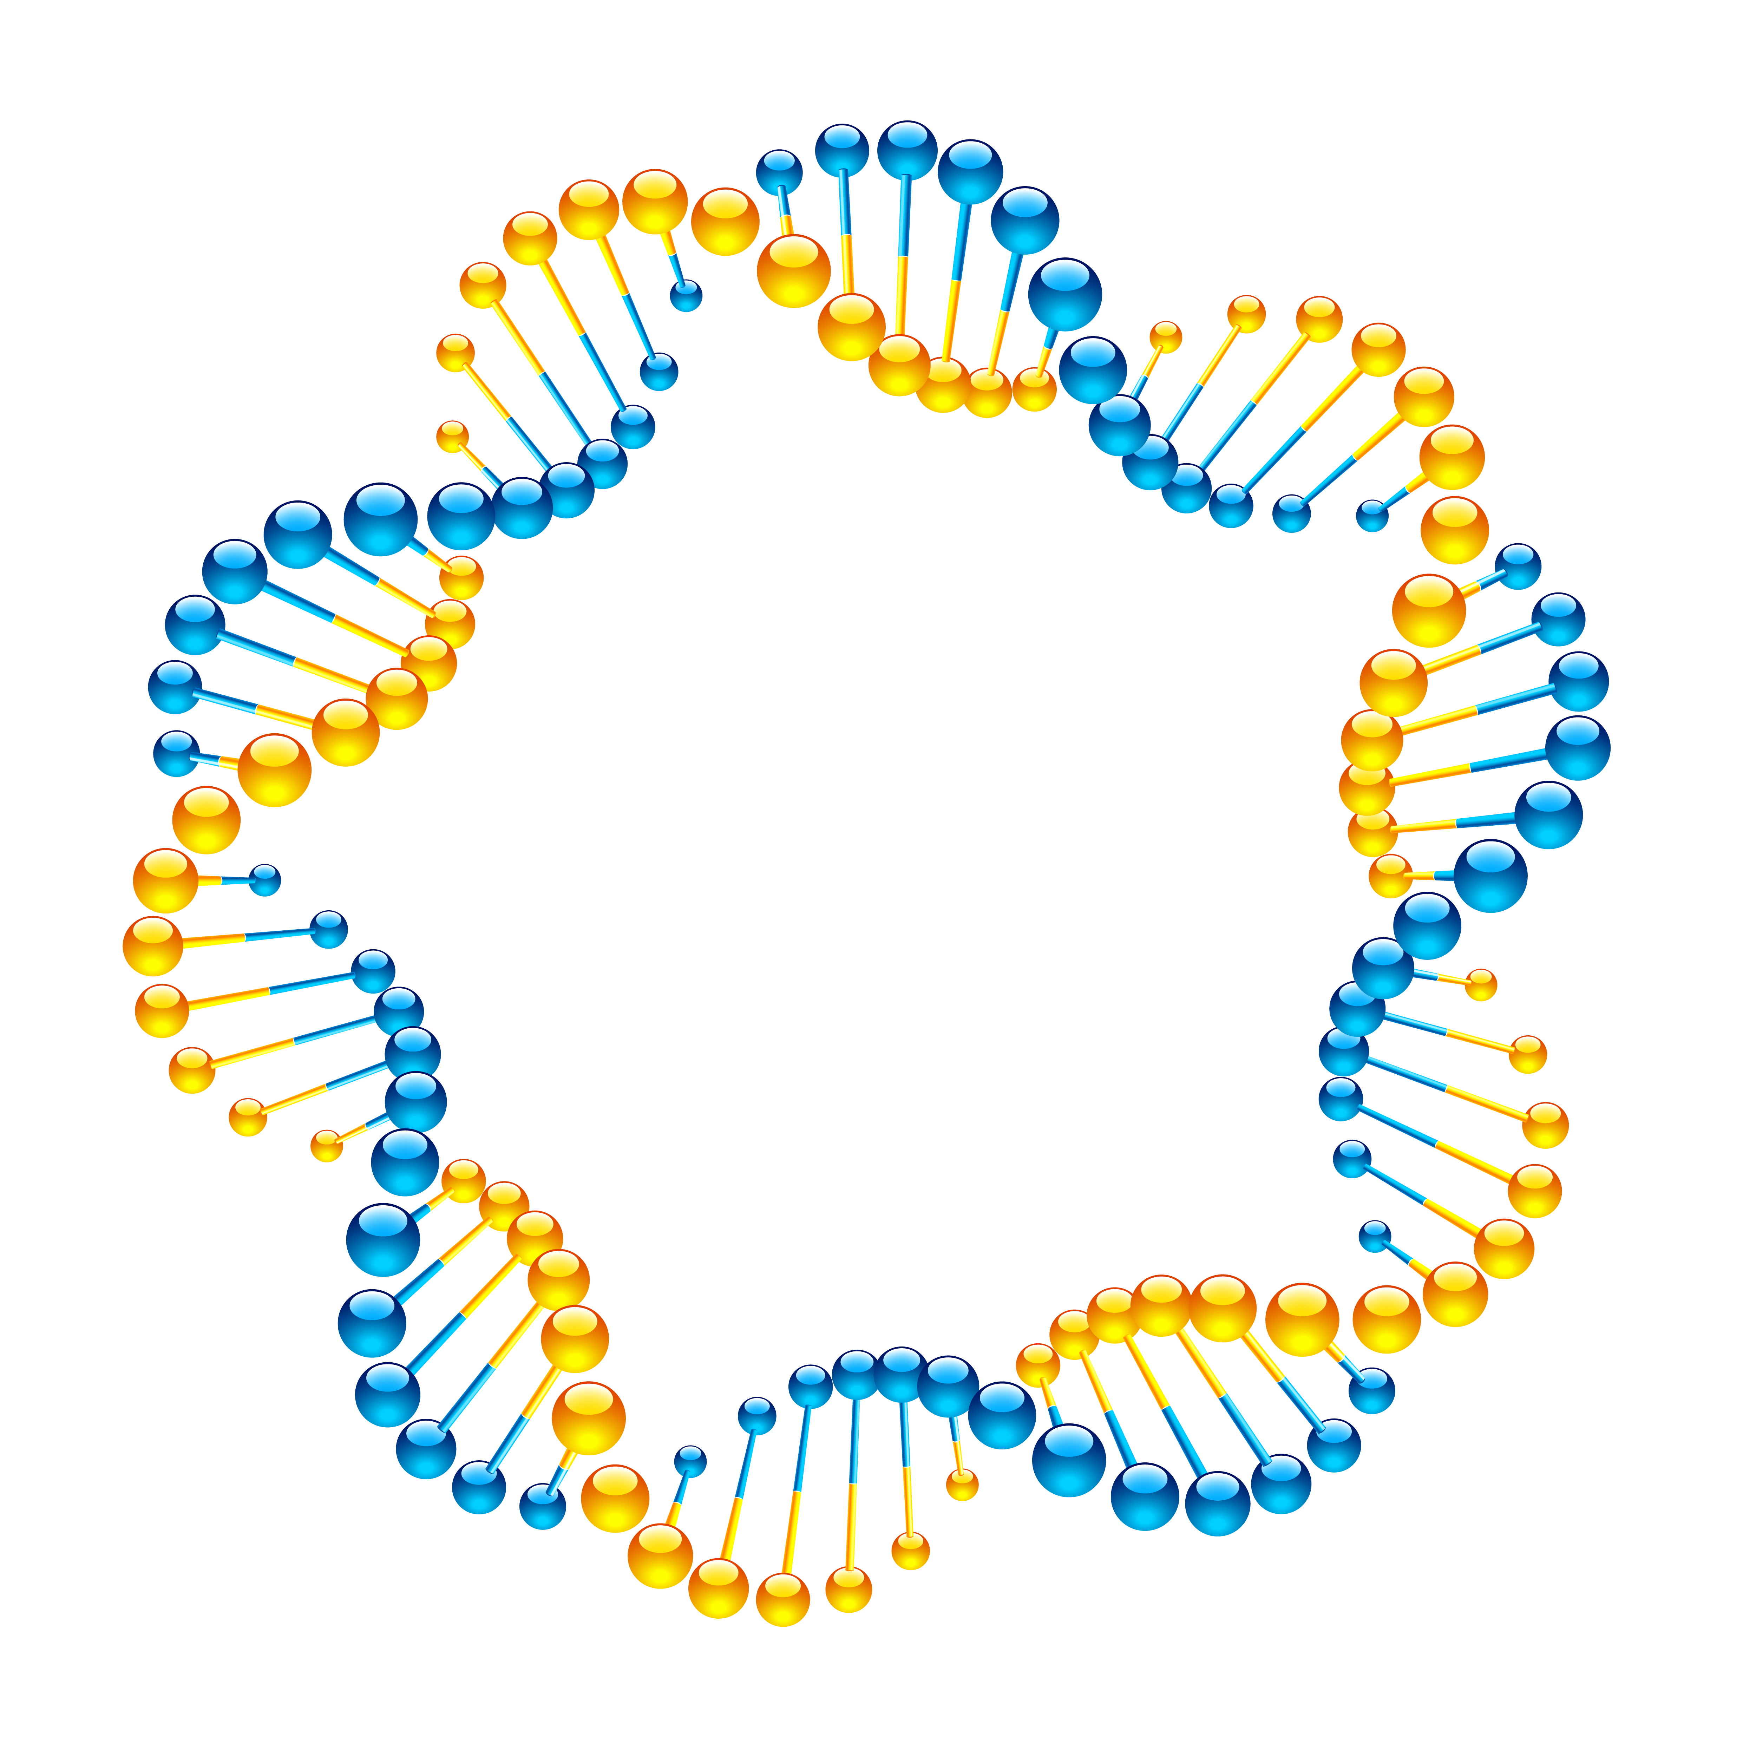
Medicinal Mushrooms
What immune-boosting qualities are being tested?
Anti-mutagenic
Anti-carcinogenic
Immunomodulatory
Anti-infection
Anti-allergenic
Anti-asthmatic
Anti-inflammatory

Slide 13
IM6 Full Spectrum Immune Complex
What if any studies or research exist on the use of the medicinal mushroom blend?

Slide 14

Synergy of Ingredients
Both immunomodulators
  NCD (zinc finger protein activation)
  IM6 Full Spectrum Immune Complex (cellular signaling)
Superior antioxidant protection
Shuttling mechanism
Two different mechanisms of action for anti-mutagenesis
Greater result from combination

