Slide 1
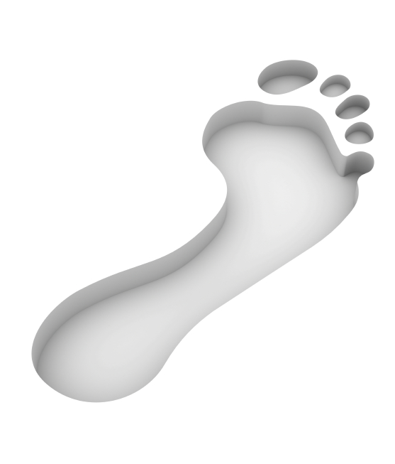
You are Surrounded
Living in a world surrounded by toxins and germs, we are constantly trying to stay one step ahead.

Slide 2
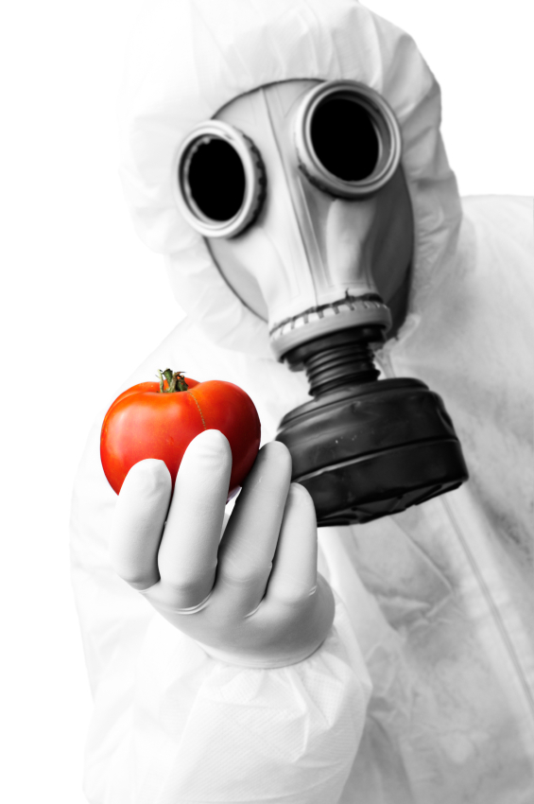
There’s No Escape
We not only live among toxins and bacteria we ingest them.

Slide 3
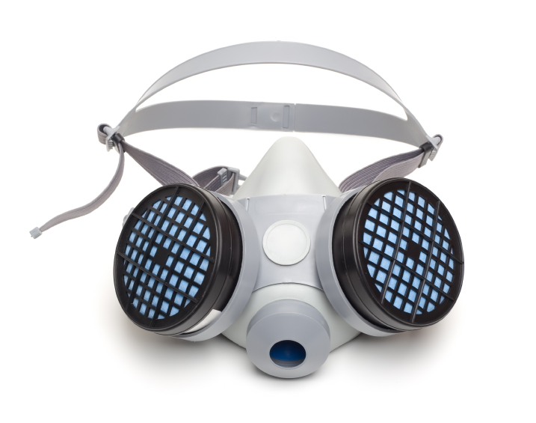
Your Immune System
A built in, protective mechanism designed to defend you against invading bacteria, microbes, viruses, toxins and parasites.

Slide 4
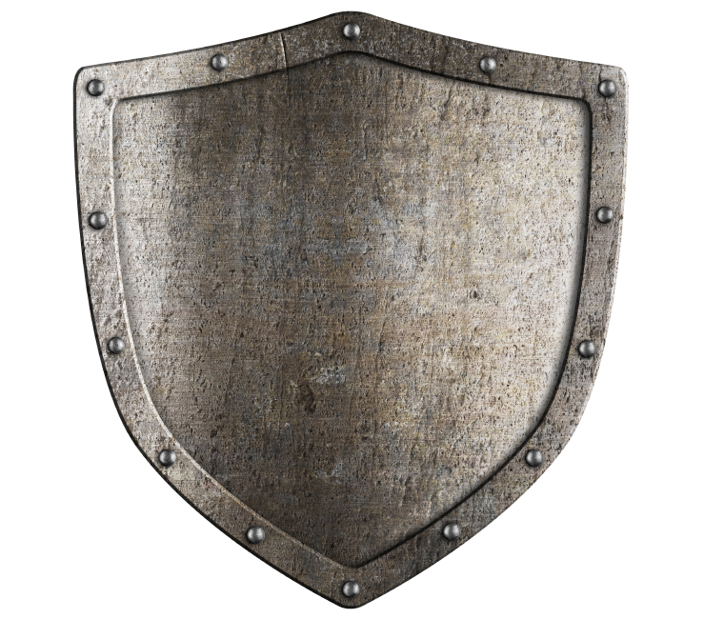
Your Immune System Protects in 3 Ways
It creates a barrier that prevents bacteria and viruses from entering your body.
If a bacteria or virus does get into the body, the immune system tries to detect and eliminate it before it can make itself at home and reproduce.
If the virus or bacteria is able to reproduce and start causing problems, your immune system is in charge of eliminating it.
3

Slide 5
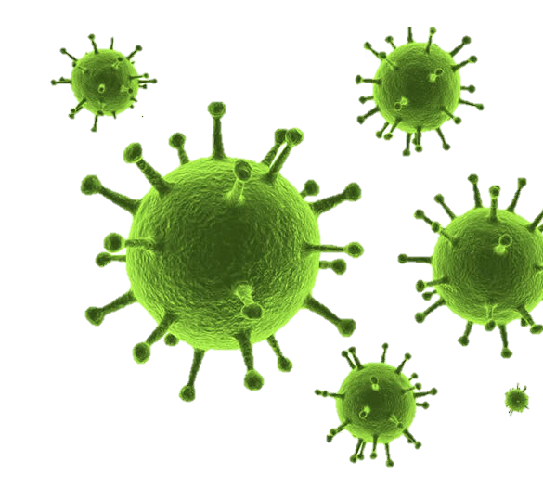
Germs and Your Immune System
Your immune system deals with most germs, bacteria and viruses without a problem.
Occasionally a germ gets past the immune system and you catch a cold, get the flu or worse.

Slide 6
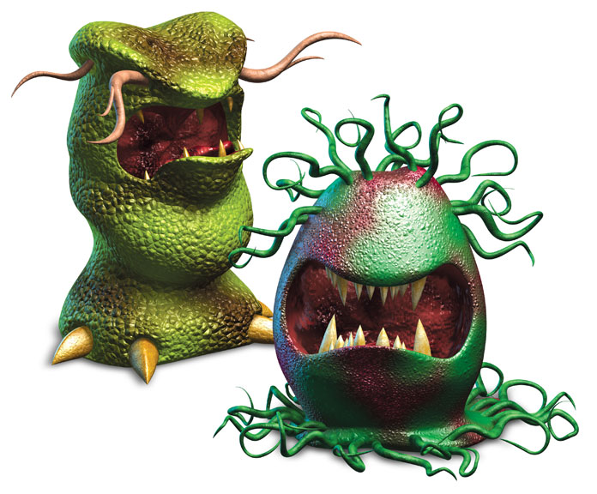
Germs and Your Immune System
When a virus or bacteria invades your body and reproduces, it can cause things like influenza, measles, mumps, malaria, AIDS and so on.
It’s your immune system’s job to protect your body from these infections.

Slide 7
Did You Know…
Drinking fountain spigot has 2.7 million microbes per square inch
Phone has 25,127 microbes per square inch
Desk surface has 20,961 microbes per square inch
Keyboards have 3,295 microbes per square inch
Mouse has 1,676 microbes per square inch
Notes:
Stan spoke about this toxic world we live in and how this is a world that we created. And now as we live among all of these toxins – and come in contact with them in our food, water, and air around us – we are continuously playing catch up. Trying to stay one step ahead.

Slide 8
Did You Know…
Average person touches 300 surfaces in 30 minutes and their face more than 600 times a day
Cold and flu viruses can survive up to three days on high-touch surfaces
Germs transmitted from a sneeze or cough can travel up to 3 feet.
A person averages 400 colds and flus in their lifetime
Notes:
Stan spoke about this toxic world we live in and how this is a world that we created. And now as we live among all of these toxins – and come in contact with them in our food, water, and air around us – we are continuously playing catch up. Trying to stay one step ahead.

Slide 9
Did You Know…
You have between 2 and 10 million bacteria between your fingertip and elbow
Damp hands spread 1,000 times more germs than dry hands
The number of germs on your fingertips doubles after you use the toilet
Germs can stay alive on your hands for up to 3 hours
Millions of germs hide under watches, ring and bracelets
Notes:
Stan spoke about this toxic world we live in and how this is a world that we created. And now as we live among all of these toxins – and come in contact with them in our food, water, and air around us – we are continuously playing catch up. Trying to stay one step ahead.

Slide 10
Did You Know…
Women’s office has 3 times as many bacteria as men.
Men’s wallets are 4 times as “germy” as purses.
There’s as much bacteria on a cell phone as there is on the handle of the men’s room.
There’s more bacteria on a remote control than a toilet bowl handle.
Double-dipping a chip transfers 10,000 microbes to the dip
Notes:
Stan spoke about this toxic world we live in and how this is a world that we created. And now as we live among all of these toxins – and come in contact with them in our food, water, and air around us – we are continuously playing catch up. Trying to stay one step ahead.

Slide 11
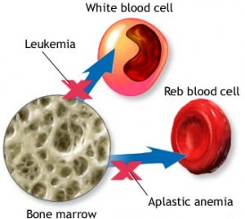
Toxins and Your Immune System
Studies have shown that when toxic exposure reduces NK cells activity, we are vulnerable to a host of infections and cancer.
In fact, in high enough doses, toxins can poison bone marrow, the heart of the immune system.

Slide 12
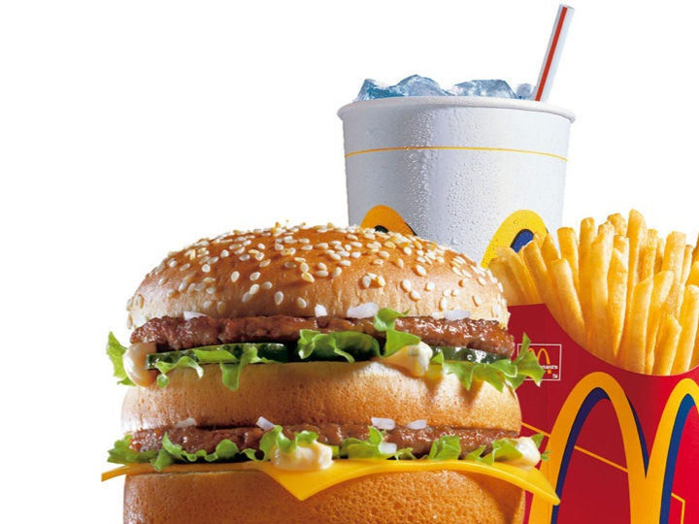
Toxins and Your Immune System
Even toxins like junk food, medications (drugs), sugars, excess alcohol, and allergens all stress your immune system, thus making it weak and unable to fight germs when exposed to them.

Slide 13
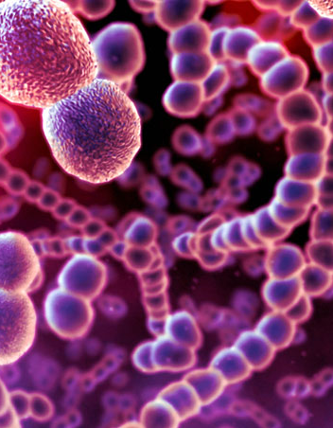
What are Germs?
Germs are tiny organisms that creep into our bodies and attack our immune system.
Notes:
Stan spoke about this toxic world we live in and how this is a world that we created. And now as we live among all of these toxins – and come in contact with them in our food, water, and air around us – we are continuously playing catch up. Trying to stay one step ahead.

Slide 14
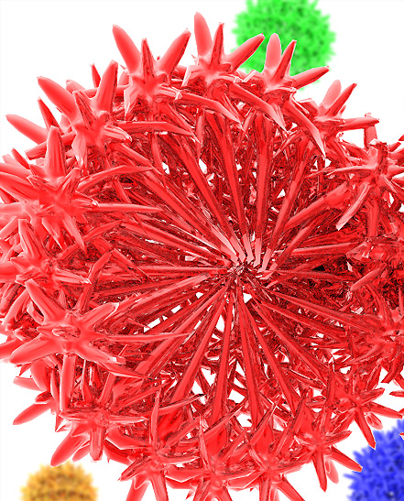
Types of Germs
There are many different kinds of germs, but the four most common are: bacteria, viruses, fungi and protozoa. Each of these types of germs cause different symptoms or illnesses.
Notes:
Stan spoke about this toxic world we live in and how this is a world that we created. And now as we live among all of these toxins – and come in contact with them in our food, water, and air around us – we are continuously playing catch up. Trying to stay one step ahead.

Slide 15
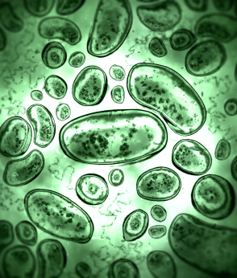
What do Germs do?
Influenza
Allergies
Hay fever
Eczema
Asthma
Rheumatoid arthritis
juvenile (type 1) diabetes,
Multiple sclerosis
WORSE!
Notes:
Stan spoke about this toxic world we live in and how this is a world that we created. And now as we live among all of these toxins – and come in contact with them in our food, water, and air around us – we are continuously playing catch up. Trying to stay one step ahead.

Slide 16
How do Germs Infiltrate Your Body?
Through any opening in the body—eyes, mouth, nose, etc.,—and through any breaks in the surface of the skin, cuts and scratches.
Notes:
Stan spoke about this toxic world we live in and how this is a world that we created. And now as we live among all of these toxins – and come in contact with them in our food, water, and air around us – we are continuously playing catch up. Trying to stay one step ahead.

Slide 17
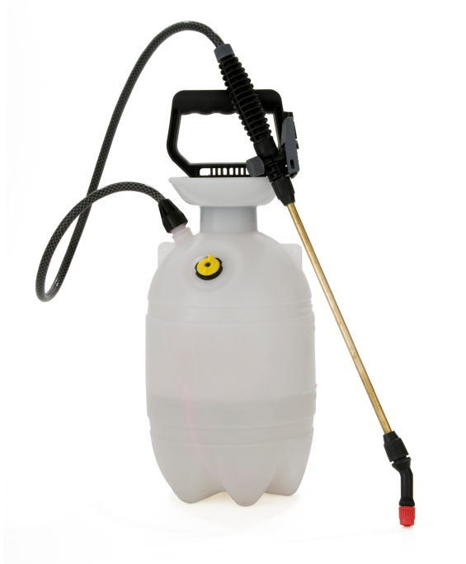
What are Toxins?
Toxins are small molecules, peptides, or proteins that can cause disease on contact with or absorption through body tissues interacting with enzymes or receptors in the cells.
Notes:
Stan spoke about this toxic world we live in and how this is a world that we created. And now as we live among all of these toxins – and come in contact with them in our food, water, and air around us – we are continuously playing catch up. Trying to stay one step ahead.

Slide 18
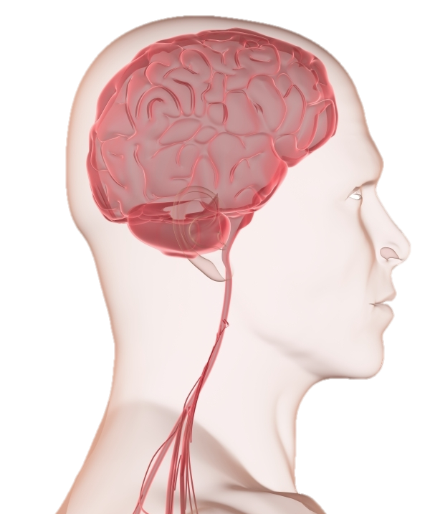
What do They do?
Brain damage
Kidney failure
Loss of muscle coordination
Poor cognitive function
Hearing and vision loss
Notes:
Stan spoke about this toxic world we live in and how this is a world that we created. And now as we live among all of these toxins – and come in contact with them in our food, water, and air around us – we are continuously playing catch up. Trying to stay one step ahead.

Slide 19
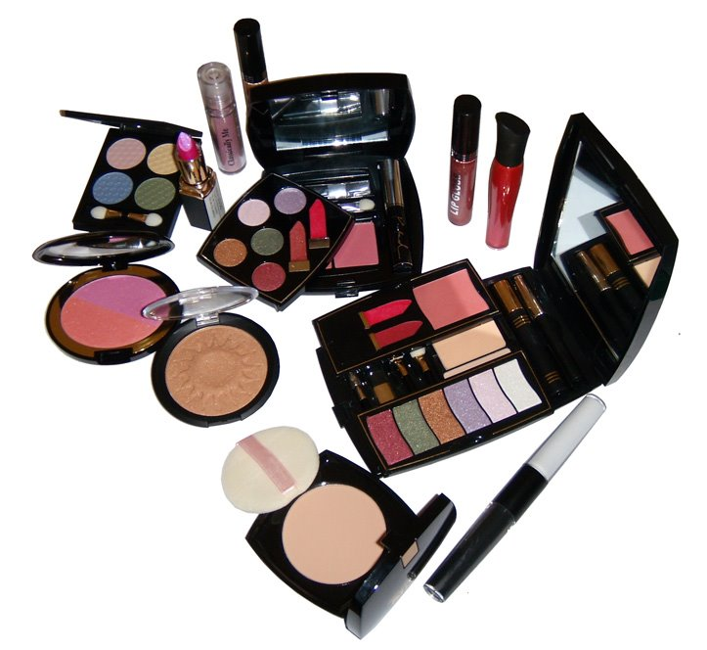
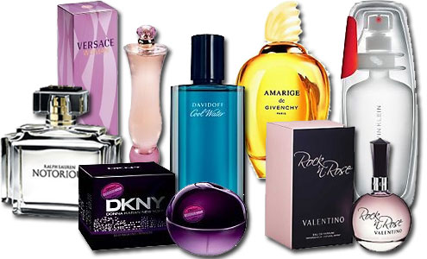
Where are They?
Air you breathe
Water your drink
Food you eat
Toiletries you use
Medications you take
Cleaning products
EVERYWHERE!!
Notes:
Stan spoke about this toxic world we live in and how this is a world that we created. And now as we live among all of these toxins – and come in contact with them in our food, water, and air around us – we are continuously playing catch up. Trying to stay one step ahead.

